Slide 1
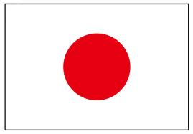


First Technical Workshop on
Standards for Hazard Monitoring, Database, Metadata
And Analysis Techniques
To Support Risk Assessment
10th to 14th June 2013
Geneva
Disaster Management Framework and
Hazard Database in Japan
Nobuyuki Tanaka
Japan Meteorological Agency

Slide 2
Outline
Background of disaster countermeasures in Japan
Governance and Institutional Arrangements
Natural Disasters in Japan
Collecting and Sharing of Disaster Damage Data
Meteorological Data Monitoring
Hazard Maps and Examples of Disaster Data Analysis
Summary

Slide 3
Background of disaster countermeasures in Japan
Governance and Institutional Arrangements
Natural Disasters in Japan
Collecting and Sharing of Disaster Damage Data
Meteorological Data Monitoring
Hazard Maps and Examples of Disaster Data Analysis
Summary

Slide 4
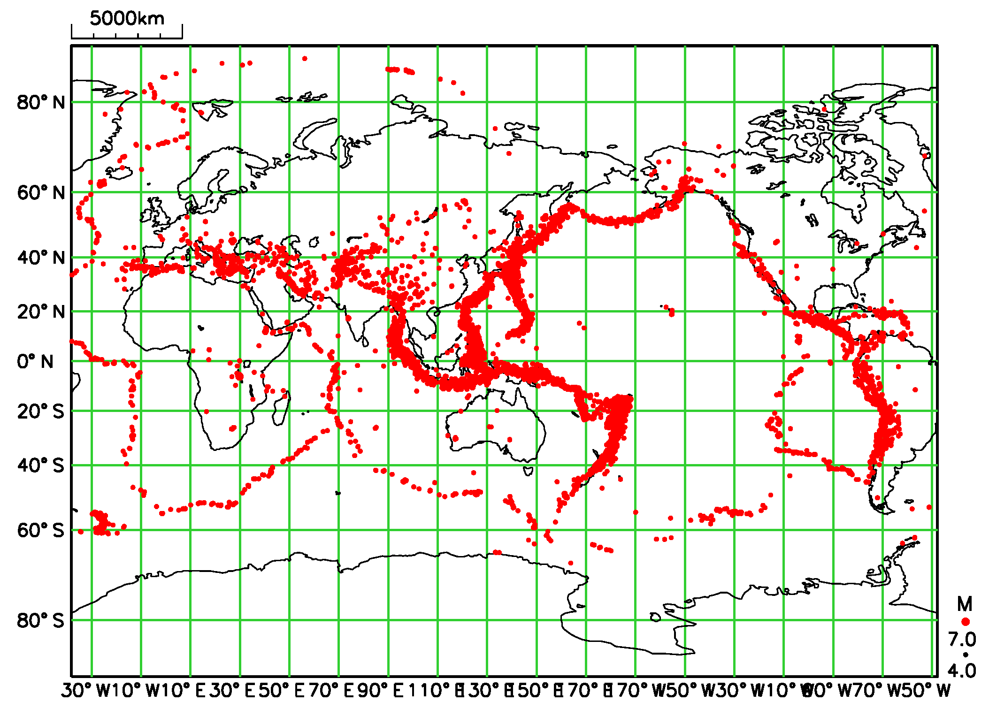
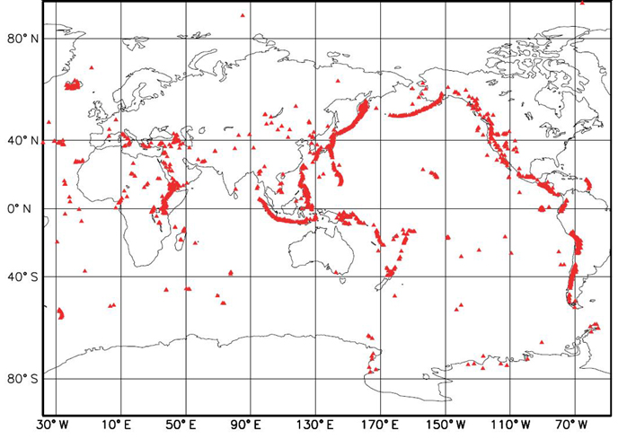
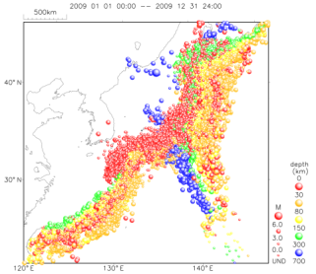
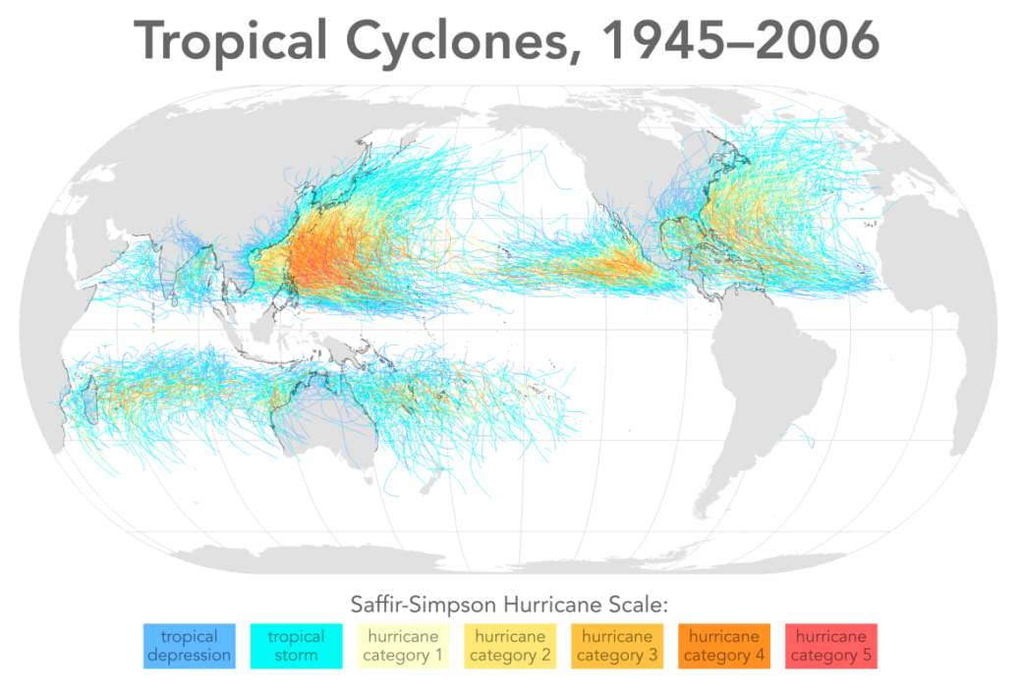
Background
Earthquakes
Volcanoes
Hypocenters around Japan
135,700 quakes in 2009
(approx. 370/day)
110 volcanoes in Japan
Tropical Cyclones
11 TCs / year (approach)
3 TCs / year (landfall)

Slide 5
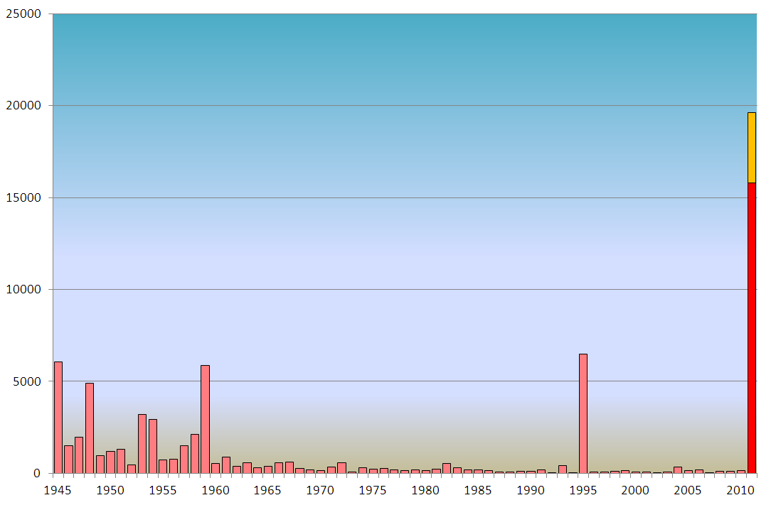
Number of victim or missing due to natural disaster
As of Oct. 18, 2011
Missing(Yellow)
The Great East Japan Earthquake
The Great Hanshin-Awaji Earthquake
Victim / Missing
The Ise-Wan Bay Typhoon
Victim(Red)
(Source: Based on Fire and Disaster Management Agency data)

Slide 6
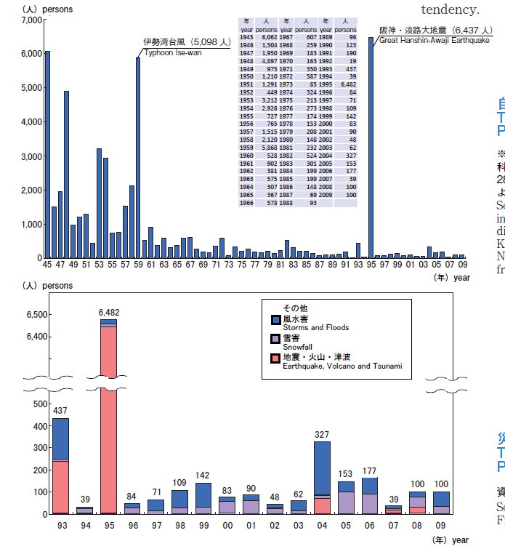
Number of victim or missing by type of disaster
persons
Storms and Floods
Snowfall
Earthquake, Volcano and Tsunami
Great Hanshin-Awaji Earthquake (1995)
Year
(Source: Based on Fire and Disaster Management Agency data)

Slide 7
Background of disaster countermeasures in Japan
Governance and Institutional Arrangements
Natural Disasters in Japan
Collecting and Sharing of Disaster Damage Data
Meteorological Data Monitoring
Hazard Maps and Examples of Disaster Data Analysis
Summary

Slide 8
Disaster Management Laws and Systems
Japan enacted various kinds of laws for disaster management especially for the purpose of disaster emergency response.
The disaster management system has been developed and strengthened following the bitter experiences of large-scale disasters and accidents.
The Disaster Countermeasures Basic Act in 1961 formulates a comprehensive and strategic disaster management system.

Slide 9
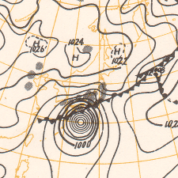
Establishment of a Comprehensive Disaster Management System after large-scale Disaster
The Ise-wan Typhoon, or Typhoon Vera (1959), attacked middle part of Japan on 26 September, 1959. About 4,700 people were killed, about 400 people were lost and more than 38,000 people were injured.
After Ise-wan Typhoon,
the Government of Japan enacted the Disaster Countermeasures Basic Act.
JMA’s observation networks and forecast techniques have been largely advanced. Such as AWS and Radar systems, and NWP.
Weather map
00UTC on September 26

Slide 10
Disaster Countermeasures Basic Act
Main contents of the Disaster Countermeasure Basic Act
Definition of responsibilities for disaster management
Disaster management organizations
Disaster management planning system
Disaster prevention and preparedness
Disaster emergency response
Disaster recovery and rehabilitation
Financial measures
State of disaster emergency
Based on this Act, Basic Disaster Management Plan is prepared by the Central Disaster Management Council as a basis for disaster reduction activities.

Slide 11
Organization of National Government and Cabinet Office
Central Disaster Management Council
Prime Minister
+ Heads of Designated Corporations
(Japanese Red Cross Society etc.)
Ministers
Chief Cabinet Secretary
Minister of State for Disaster Management
Ministries related to disaster management
Cabinet Secretariat in charge of security and risk management
Disaster Management,
Cabinet Office
Mutual Collaboration
Ministry of Internal Affairs and Communications
Fire and Disaster Management Agency
Ministry of Justice
Ministry of Foreign Affairs
The Small and Medium Enterprise Agency
Ministry of Finance
Ministry of Education, Culture, Sports, Science and Technology
Agency for Natural Resources and Energy
Ministry of Health, Labour and Welfare
Ministry of Agriculture, Forestry and Fisheries
Nuclear and Industrial Safety Agency
Ministry of Economy, Trade and Industry
Ministry of Land, Infrastructure, Transport and Tourism
Geospatial Information Authority
Ministry of the Environment
Japan Meteorological Agency
Ministry of Defense
Japan Coast Guard
(Organization chart has been simplified from a real organization chart)

Slide 12
Outline of the Disaster Management System
[National level]
Prime Minister
|
Central Disaster Management Council
|
Designated Government Organizations
Designated Public Corporations
Formulation and promoting implementation of the Basic Disaster Management Plans
Formulation and promoting implementation of Disaster Management Operation Plans
[Prefectural level]
Governor
Prefectural Disaster Management Council
Designated Local Government Organization
Designated Local Public Corporations
Designated Government Organizations
24 ministries and agencies
Designated Public Corporations
56 organizations including independent administrative agencies, Bank of Japan, Japanese Red Cross Society, NHK, electric and gas companies and NTT
[Municipal level]
Mayors of Cities, Towns and Villages
Municipal Disaster Management Council
Formulation and promoting implementation of Local Disaster Management Plans
Formulation and promoting implementation of Local Disaster Management Plans
Residents level

Slide 13



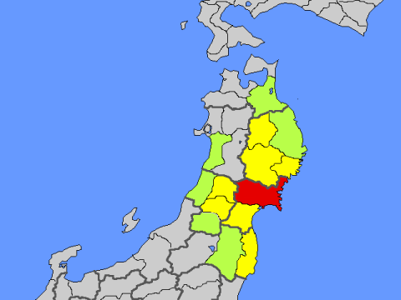

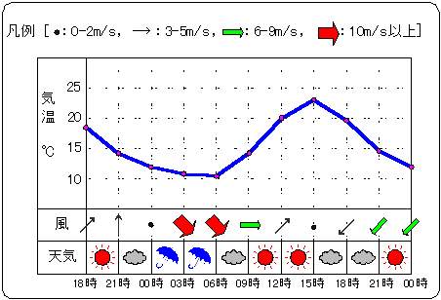
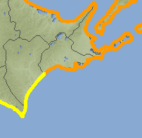
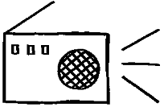

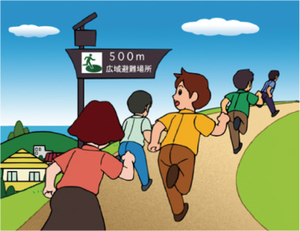
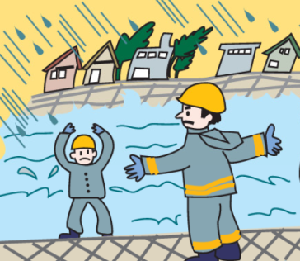
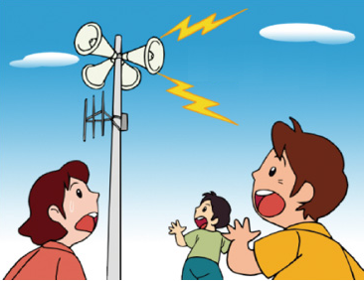

Action of Local Governments and Citizens
JMA
Headquarters
JMA Local Offices
Forecast
Warnings
火山名 ○○山 噴火警報（火口周辺）
平成20年X月X日X時X分 △△管区気象台
＜○○山に火口周辺警報（噴火警戒レベル２、火口周辺規制）を発表＞
○○山では火口周辺に影響を及ぼす噴火が予想さ
対象市町村等 △△県：□□市、◇◇村
＜噴火警戒レベルを１（平常）から２（火口周辺
津波警報
津波注意報
Information
・Prefectures
・Municipalities
Citizens
Evacuation Order
and Instruction
Staff assembling
Patrol/Caution
Evacuation

Slide 14
Background of disaster countermeasures in Japan
Governance and Institutional Arrangements
Natural Disasters in Japan
Collecting and Sharing of Disaster Damage Data
Meteorological Data Monitoring
Hazard Maps and Examples of Disaster Data Analysis
Summary

Slide 15
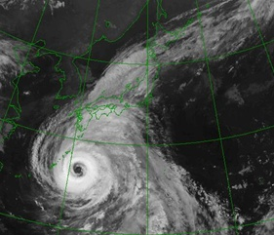
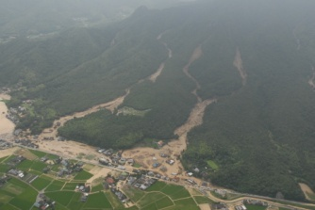
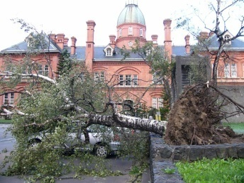
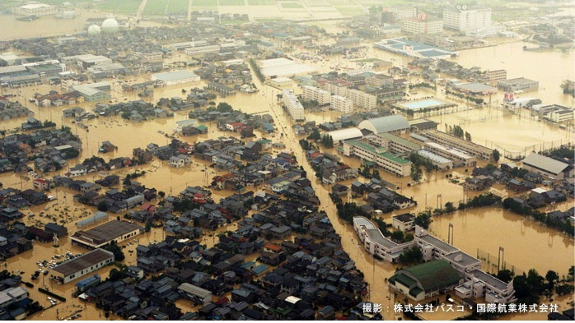
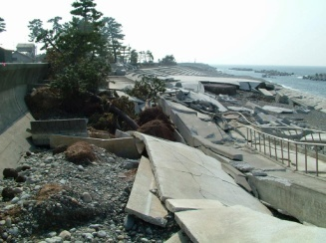
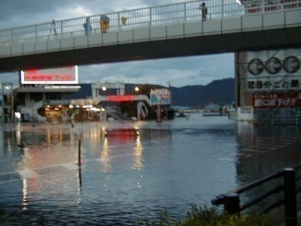
Major Meteorological Disaster in Japan: 1
Disaster related Tropical Cyclone or Developed Low or Front
Sediment Disaster
Storm
River Flood
High Wave
Storm Surge

Slide 16
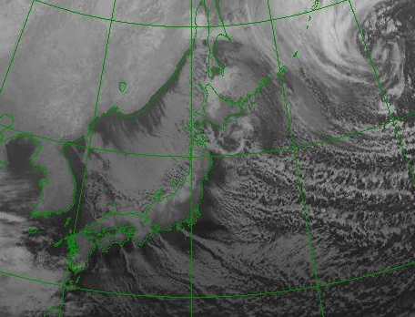
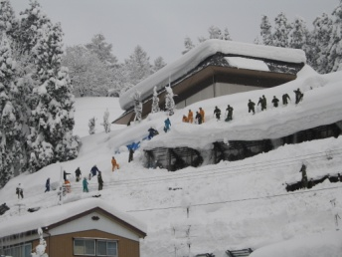
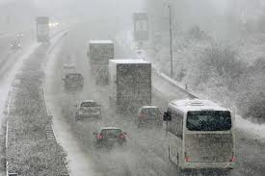
Major Meteorological Disaster in Japan: 2
Disaster related Monsoon or Developed Low
Heavy Snow
Snow Storm
High Wave

Slide 17

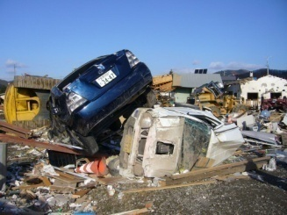
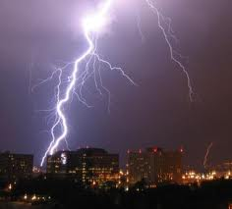
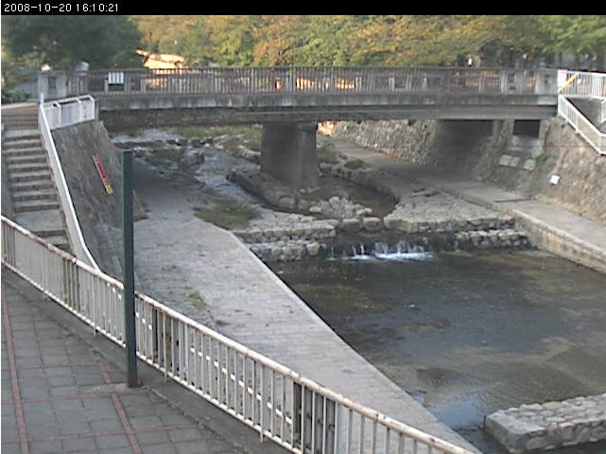
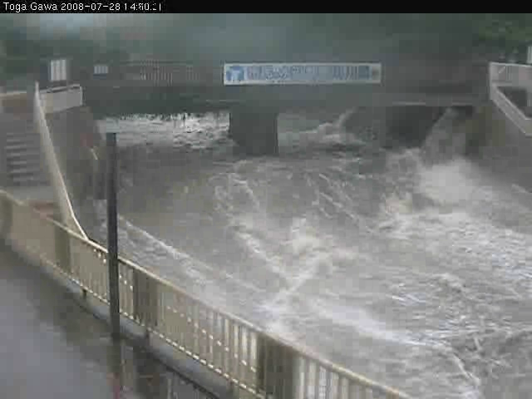
Major Meteorological Disaster in Japan: 3
Disaster related Developed Cumulonimbus
Tornado
Thunderstorm
Flash Flood

Slide 18
Weather Warnings and Advisories
Warnings
Storm | Snow-storm | Heavy rain | Heavy snow
Storm surge | High waves | Flood
Advisories
Gale and snow | Gale | Heavy rain
Heavy snow | Dense fog | Thunderstorm
Dry air | Avalanche | Ice (snow) accretion
Frost | Low temperature | Snow melting
Storm surge | High waves | Flood

Slide 19
Possible Disaster related Warnings/Advisory
Warnings (7) | Advisories (16) | Disasters
Heavy Rain | Heavy Rain | Sediment Disaster; Inundation of houses, load, farming land etc.
Flood | Flood | Flood; Dike break; Washout of bank; Inundation etc. except rivers designated for joint flood forecast
Storm Surge | Storm Surge | Inundation; Damage of ships, shore facilities including ones for fishery etc.
Storm | Gale | Damage of houses, buildings, agricultural crops etc.; Maritime disaster
High Wave | High Wave | Maritime disaster; Inundation; Damage of ships, shore facilities including ones for fishery etc.
Heavy Snow | Heavy Snow | Traffic disturbance; Damage of houses etc.
Snow-storm | Gale & Snow | Traffic disturbance; Damage of houses, buildings etc.; Maritime disaster
 | Thunderstorm | Disasters caused by Thunderbolt, hail, gust (tornado, downburst)
 | Dense Fog | Traffic disturbance, Maritime disaster
 | Frost | Damage of agricultural crops in early/late winter
 | Dry Air | Fire disaster; Forest fire
 | Avalanche | Avalanche except steep mountain areas
 | Low Temperature | Water pipe freeze-up and break; Damage of agricultural crops
 | Snow-melting | Flood, Sediment disaster, Inundation
 | Ice Accretion | Significant accretion of ice on electric power cable, communication wire, vessel’s body
 | Snow Accretion | Significant accretion of snow on electric power cable, communication wire
*Warning/Advisory for Ground-loosening and Inundation are included in ones for Heavy Rain

Slide 20
Background of disaster countermeasures in Japan
Governance and Institutional Arrangements
Natural Disasters in Japan
Collecting and Sharing of Disaster Damage Data
Meteorological Data Monitoring
Hazard Maps and Examples of Disaster Data Analysis
Summary

Slide 21
Collection of Disaster Damage Data
Municipality Level
Prefecture Level
National Level
Affected Area
This Database provides the official record of the Japanese Government
Survey
Municipality
Cities, Towns
report
Cabinet Office
(Disaster Management)
Report
report
Prefecture
Government
CO
Municipality
Fire and Disaster Management Agency
Municipality
Prefecture
FDMA
Survey
report
Police Station
Prefecture Police Department
report
Japan Police Agency
JPA
Police Station
Request & Receive
Local Meteorological Observatory
report
Japan Meteorological Agency
Mass
Media
JMA
Database for analyzing Phenomena or draft Criteria of Warning/Advisory

Slide 22
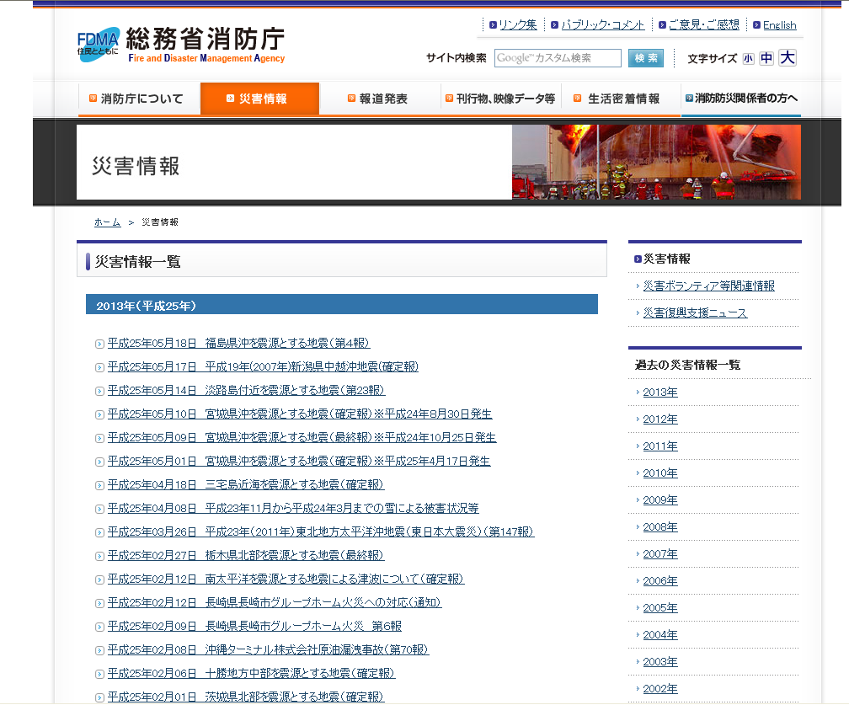
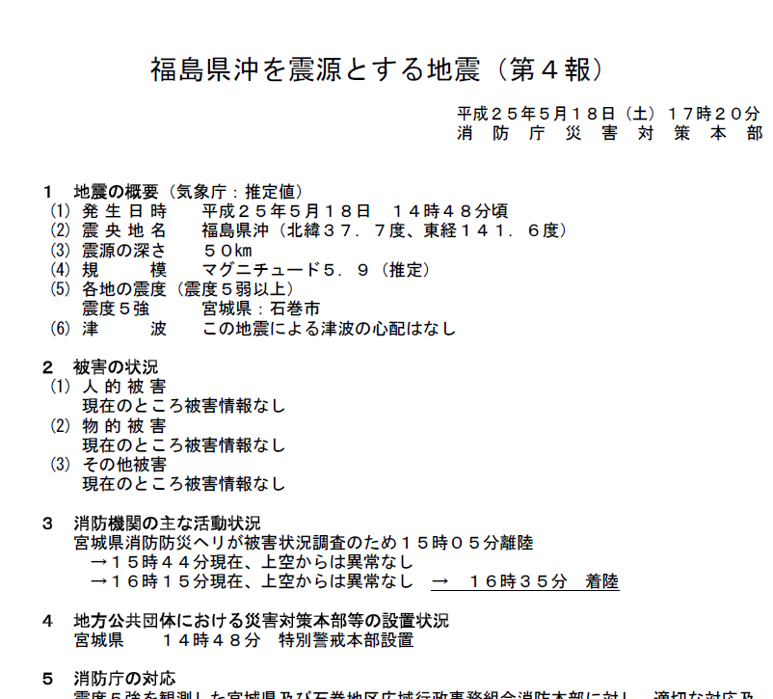
Opened Official Disaster Damage Information
Disaster Damage Information
List of Events
FDMA
Detailed Information
Archives of Past Events
Copyright © Fire and Disaster Management Agency

Slide 23

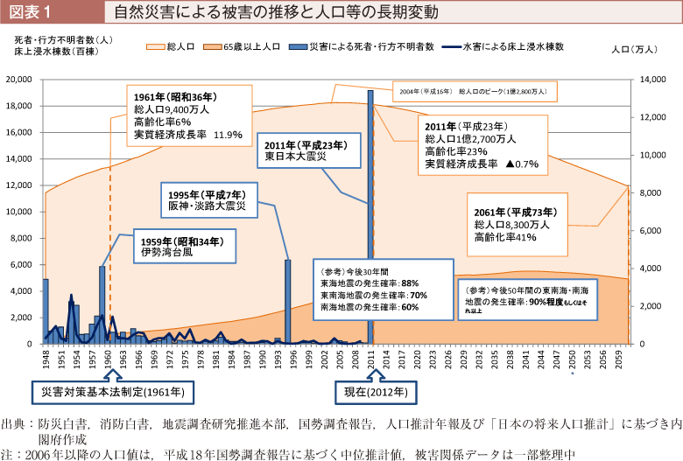
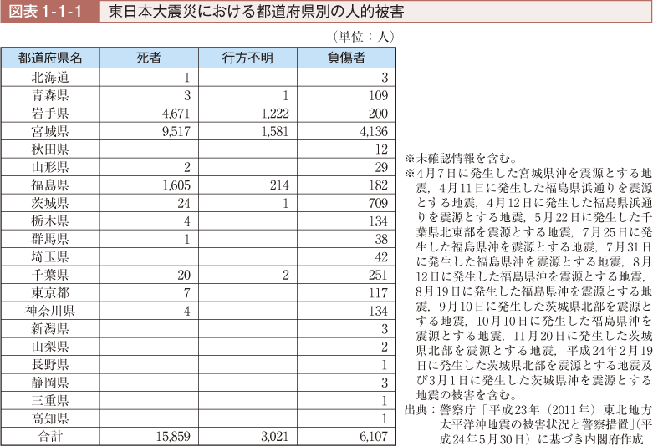
White Paper on Disaster Management
2012
White Paper on Disaster Management
Official Disaster Record
Cabinet Office
CO
Official Disaster Record
Copyright © Cabinet Office

Slide 24
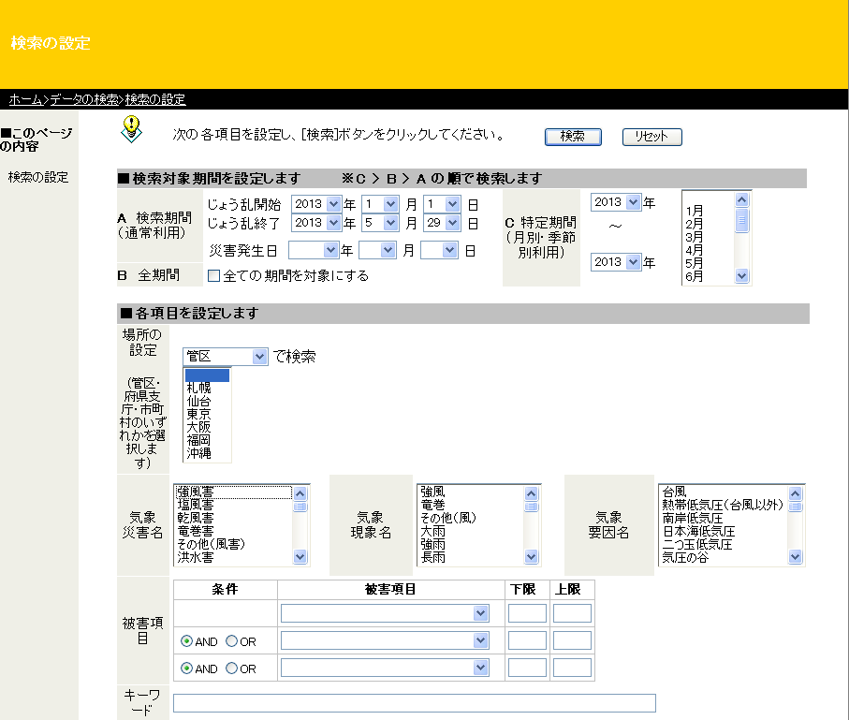
Disaster Database in JMA
Snapshot of search page
Specify by
month or season
Specify by date
Choose period
whole time
Choose area
(by region, prefecture, city)
Meteorological phenomena
Wind (include tornado)
Rain(heavy, shortage)
snow(avalanche, stuck)
Etc.
Weather system
pressure pattern (low or high)
Front (warm, cold, stationary)
Tropical cyclone (typhoon)
Trough of pressure, etc.
Choose
Weather disaster
Wind, air pollution
Flooding, landslide
Drought, heat wave
Poor visibility, ship icing
- etc.
Choose damage or loss
(details are shown in next slide)
JMA
search by keyword

Slide 25
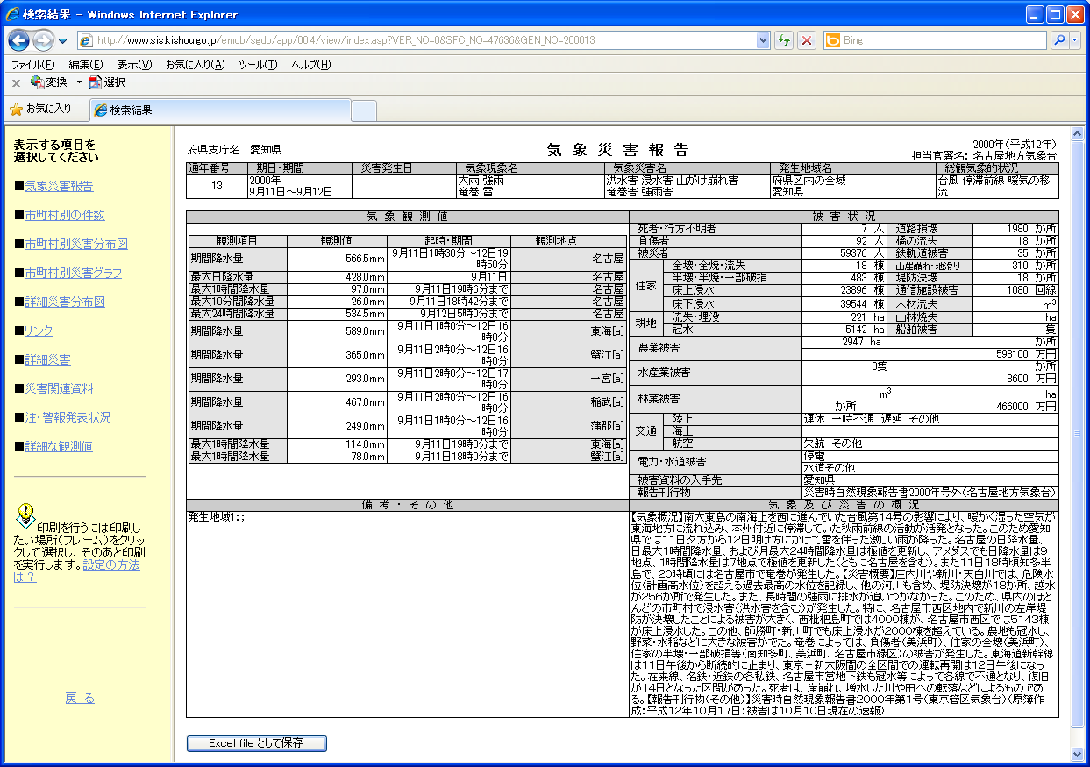
An example of Output of Disaster Database
JMA

Slide 26
An Example of Search Result
Home and Property Damage
completely or partly destroyed
Flood, washout
Outline of the event
Transportation Disruption
(delay, cancel)
Railway, bus
-ship, airplane
Human damage
Deaths and missing,
injured
(From the left)
observation element
observed value
observed time or period
observed station
- Information source
-Publication
Damage on infrastructure
road, bridge, railway, river bank
electricity, water supply,
telephone etc
Economic loss
Agriculture, fishery,
forestry

Slide 27
Background of disaster countermeasures in Japan
Governance and Institutional Arrangements
Natural Disasters in Japan
Collecting and Sharing of Disaster Damage Data
Meteorological Data Monitoring
Hazard Maps and Examples of Disaster Data Analysis
Summary

Slide 28

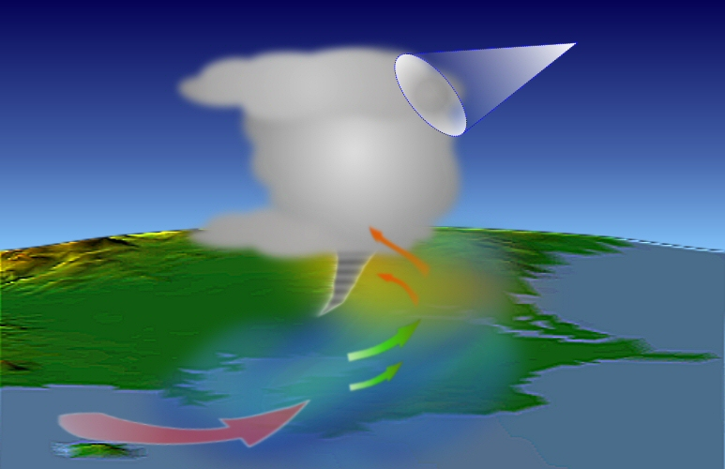




Meteorological Observation System by JMA
Meteorological Satellite
(MTSAT)
Automated Balloon Launcher
Meteorological Radar
Headquarter
Weather Station
Wind Profiler

Slide 29
Meteorological Observation Data Archiving

Slide 30
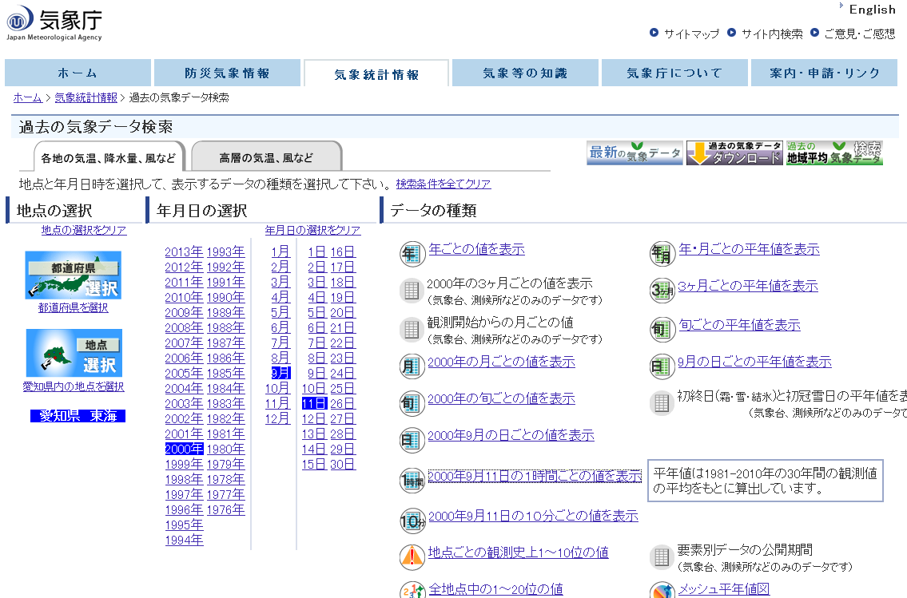
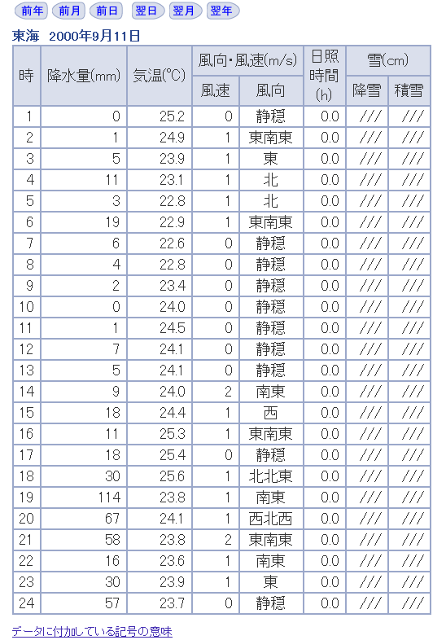
Acquire Data (AWS) through Website
Appendix IV
Example of output of database
Retrieval screen
Output Image (hourly data of one station)
Area/
Station
Year/
Month/
Day
Type of Statics
JMA
hour
Precip.
Temp.
Wind
Sunshine
Snow
Fall Depth

Slide 31
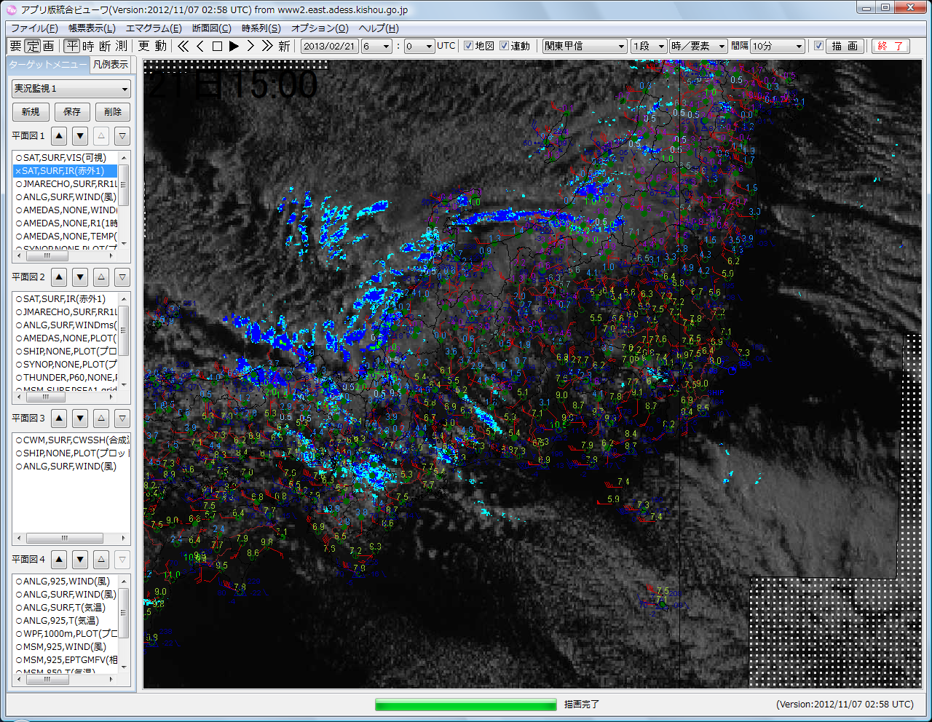
Examples of visualization tools for Meteorological Observation
Integrated Meteorological Viewer (Real-time data monitoring)

Slide 32
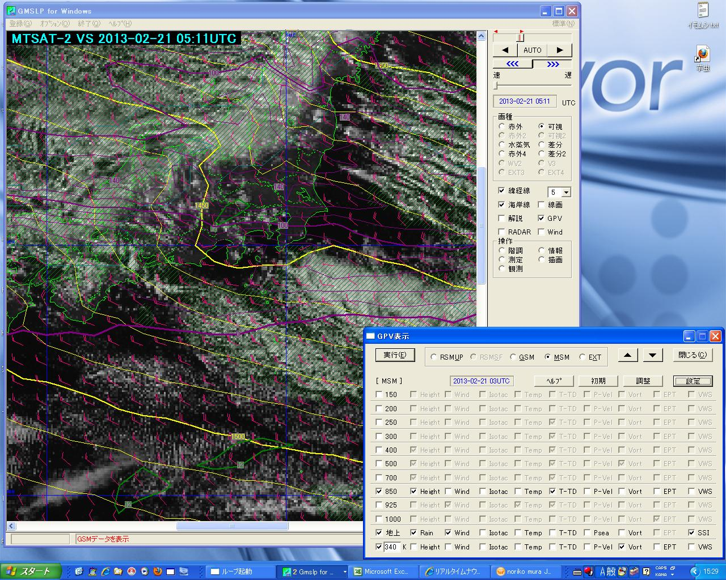
Examples of visualization tools for Meteorological Observation
SATAID (Satellite Animation and Interactive Diagnosis)

Slide 33
Background of disaster countermeasures in Japan
Governance and Institutional Arrangements
Natural Disasters in Japan
Collecting and Sharing of Disaster Damage Data
Meteorological Data Monitoring
Hazard Maps and Examples of Disaster Data Analysis
Summary

Slide 34
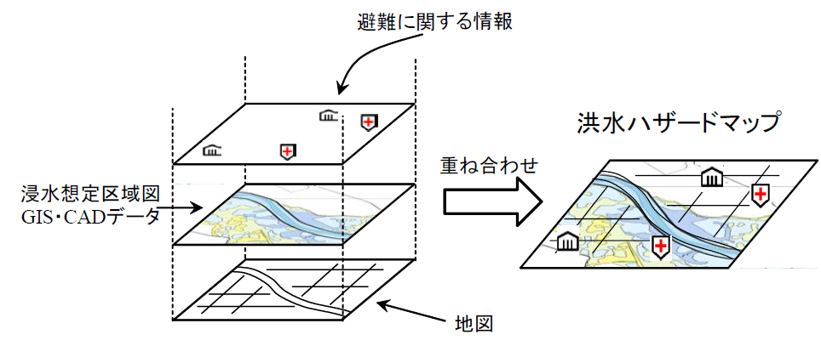
How to Create the Hazard Map in Japan
River Management Authorities
Municipality
Information about
Facilities of Evacuation
Hazard Map on Flood
Estimated Inundation Area Map (GIS or CAD)
Overlay
Map Information
Provided to Residents, Disaster Management Organization, HP etc.
From “the Guideline for Utilization of Estimated Inundation Area Map to Develop the Flood Hazard Map”
Ministry of Land Infrastructure, Transport and Tourism, Water and Disaster Management Bureau 2008
Copyright © MLIT

Slide 35
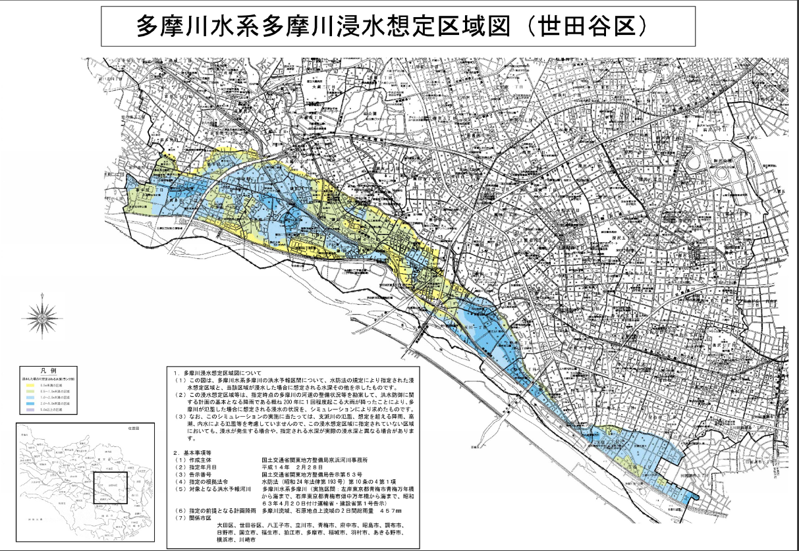
An example of Estimated inundation area map
Estimated inundation area map of Tama River for Setagaya Ward
Copyright © Keihin Office of River, Kanto Regional Development Bureau

Slide 36
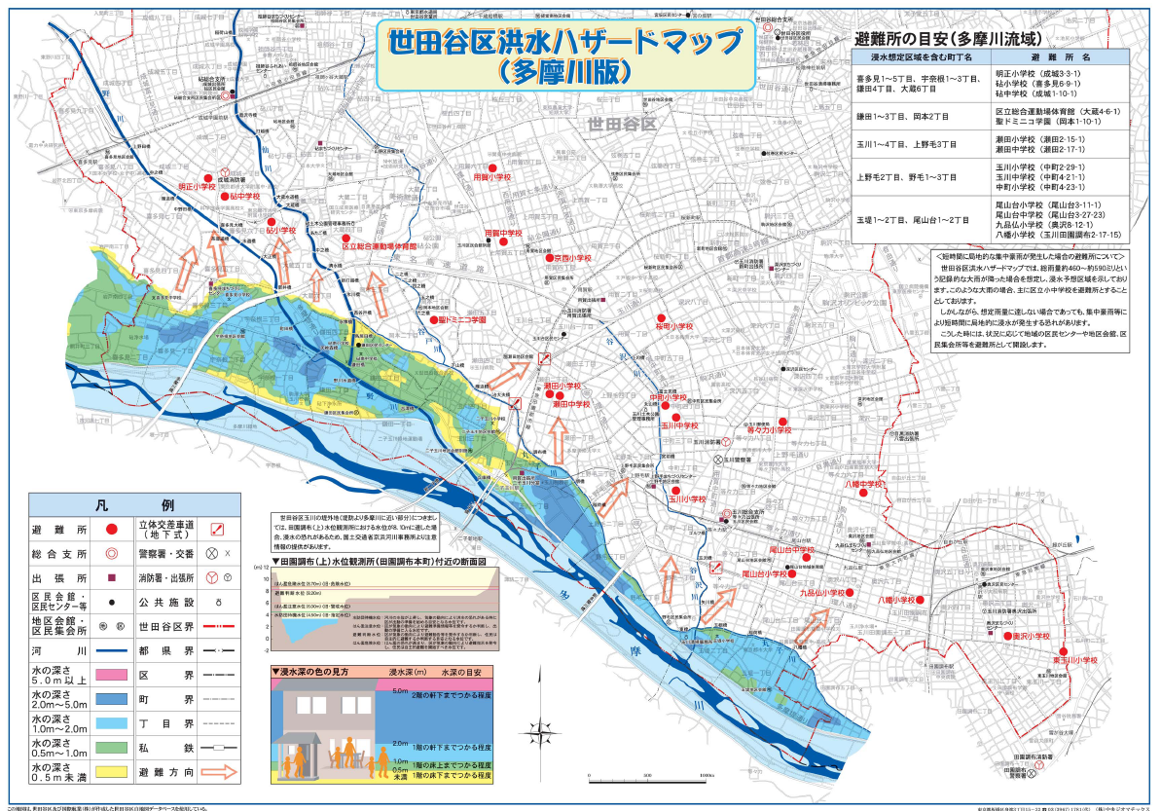
An example of Hazard Map
Hazard Map on Setagaya Ward
(Flood by Tama River)
Evacuation center
Direction for Evacuation
Information about Hazard
Copyright © Setagaya-Ward, Tokyo

Slide 37
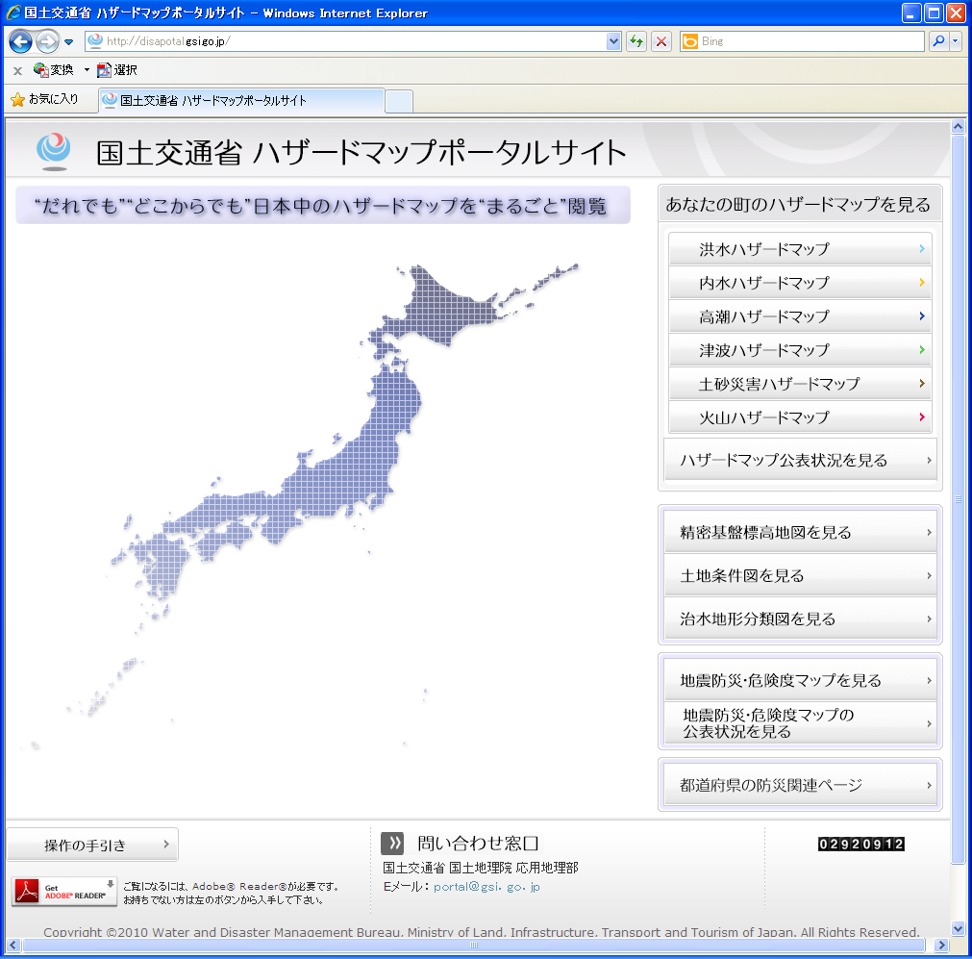
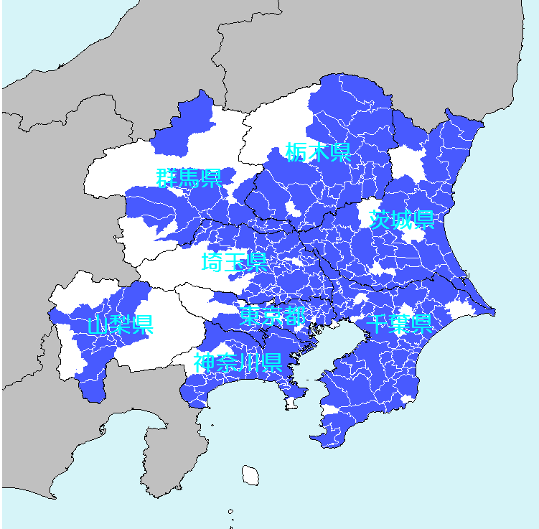
Portal website by MLIT
For Flood
For Inundation
For Storm Surge
Hazard map Portal Website by MLIT
For Tsunami
For Sediment Disaster
For Volcanic Eruption
Shows cities which open Hazard map
Click to view the each Hazard map
Copyright © Ministry of Land, Infrastructure, Transport and Tourism

Slide 38
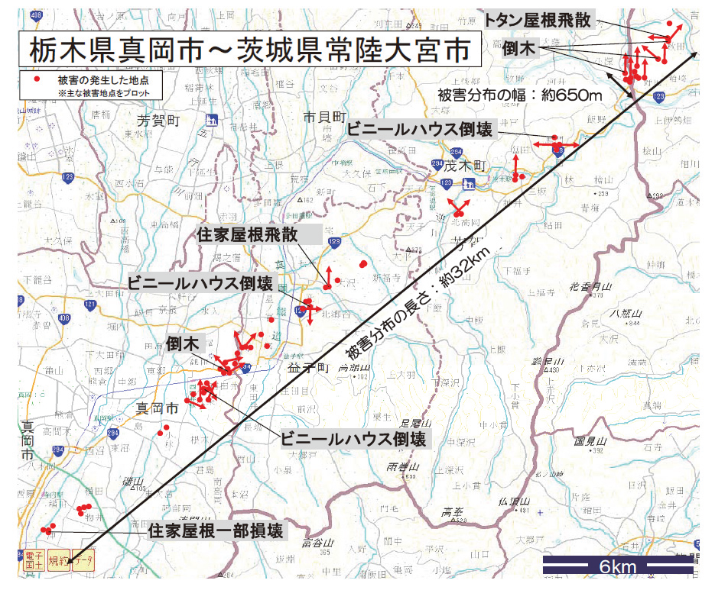
Analysis of Damage data for Identify Tornado
Mooka City, Tochigi Pref.
Hitachi-Ota City, Ibaragi Pref.
Points which found Damage
Blow off house ceiling
Collapse of greenhouse
Extent of damage signature: 32km
Fallen trees
Collapse of greenhouse
Partially destroyed of house ceiling
From Technical News by Tokyo District Meteorological Observatory

Slide 39
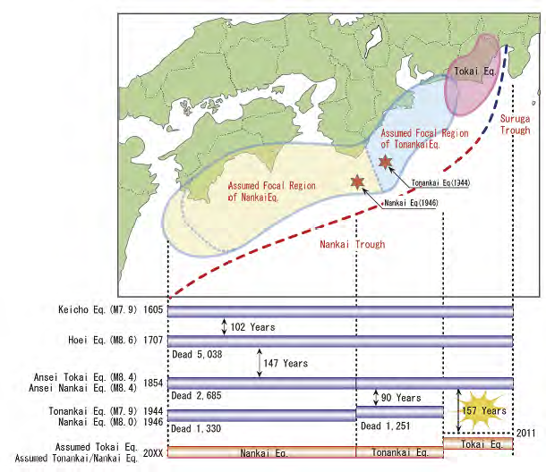
An example of analysis of Return Periods
History of Tokai, Tonankai and Nankai Earthquakes

Slide 40
Summary
Due to its geographic, topographic and meteorological condition, Japan is prone to natural disasters.
Japan’s disaster management system addresses clear roles and responsibilities of the national and local governments with cooperation in implementing various disaster countermeasures.
Japan has some database on disaster damage. Japan Meteorological Agency has and keeps update for improvising Warnings and analyzing meteorological phenomena.
Hazard maps are created overlaying two information. Estimated hazard risk and Information for evacuation.

Slide 41




Thank you for your attention!

